Slide 1
LogiTest Presentation
Xinyue Yu

Slide 2
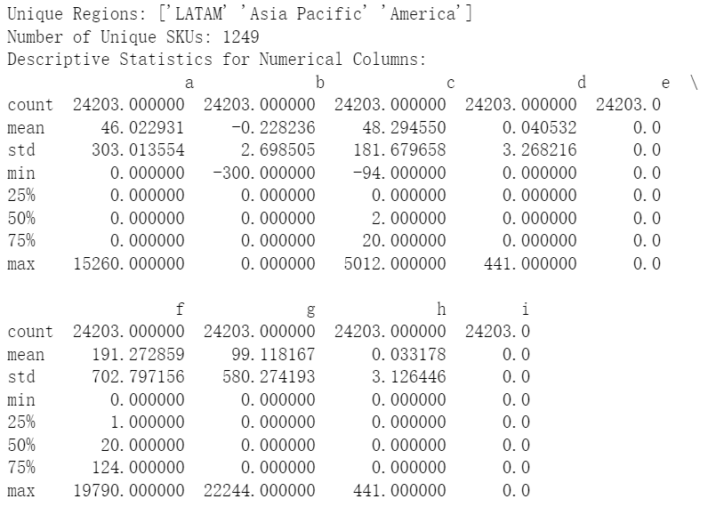
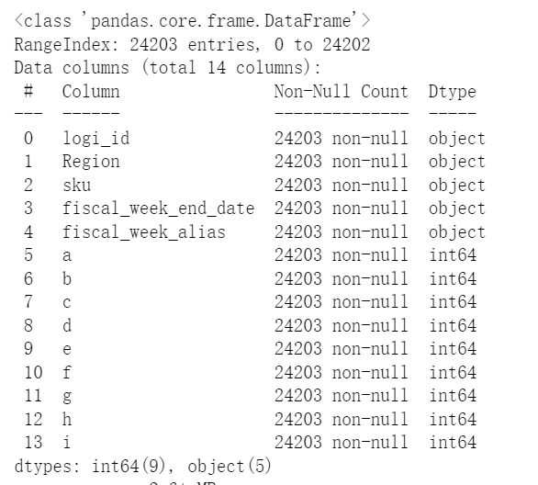
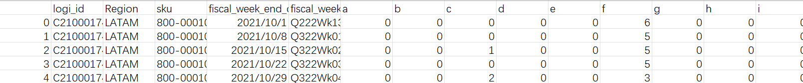
Part 1, Supply Chain Dataset: sc_data.csv
Type transformation

Slide 3
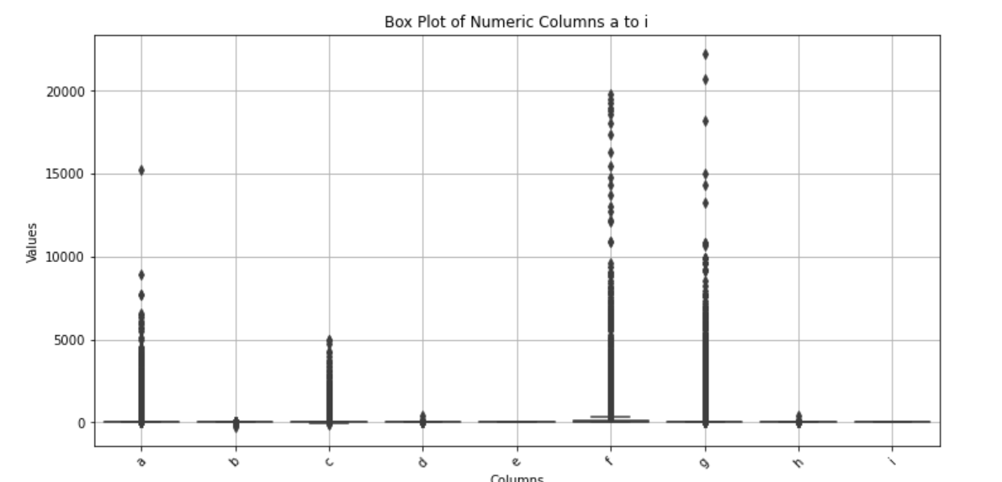

Slide 4


Part 2: Product Data Analysis
DataFrame
df_pl
df_dt
df_add
Product Line Data
Store Sales Data
Store Address Data
df_pl.csv
df_dt.csv
df_add.csv

Slide 5
1) Join Data Sets
Product Line Data
Store Sales Data
Product Line Desc
Parent Store Number
Monthly Sales Data
Product SKU
Check if all SKUs in df_dt are in df_pl and all SKUs in df_pl are in df_dt.

Slide 6
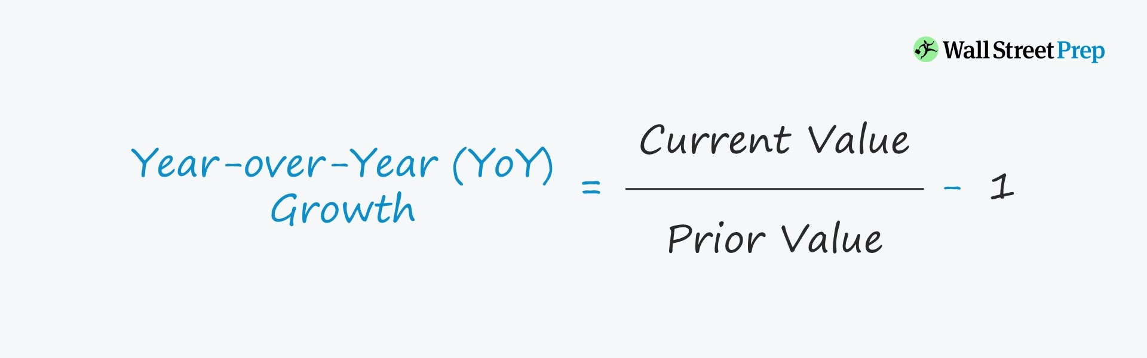
2) YoY growth by month of the product lines
YoY Growth rate=(Current Year Sales by month−Previous Year Sales by month)/
Previous Year Sales by month
To Visualize this trend:
Heatmap, Line Chart, Stacked Bar Chart.

Slide 7
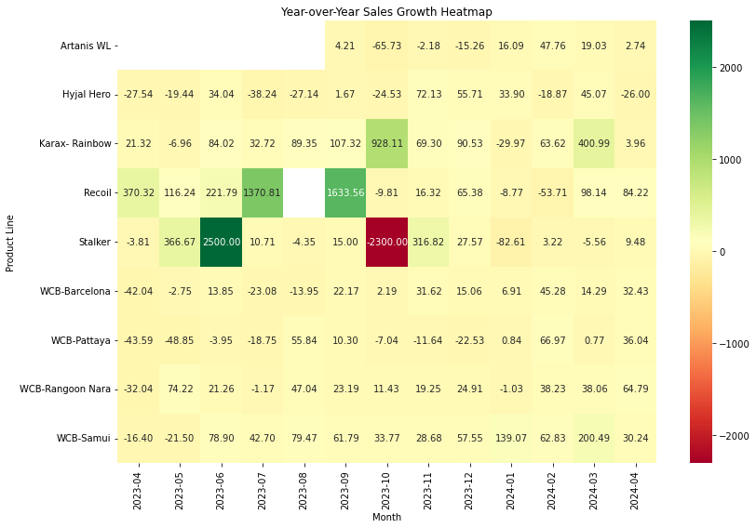
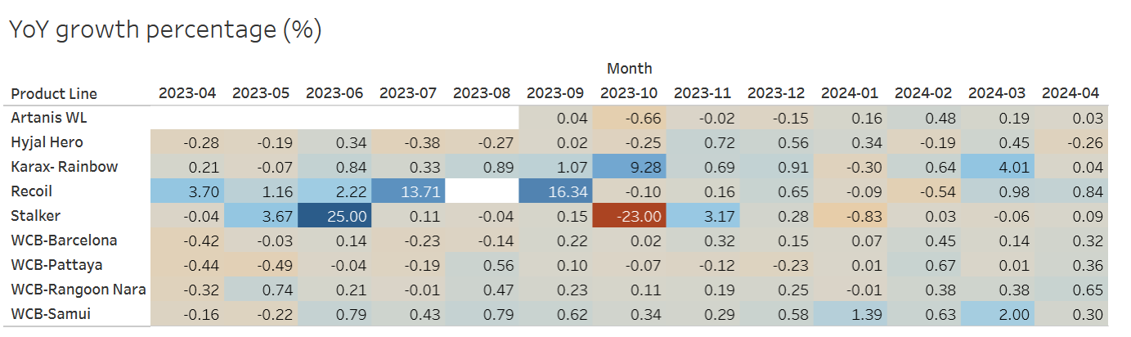
2) Sales Visualization
Heatmap

Slide 8
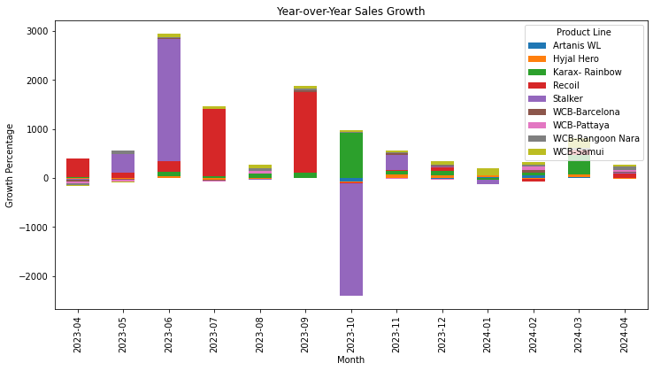
2) Sales Visualization
Stacked Bar Chart

Slide 9
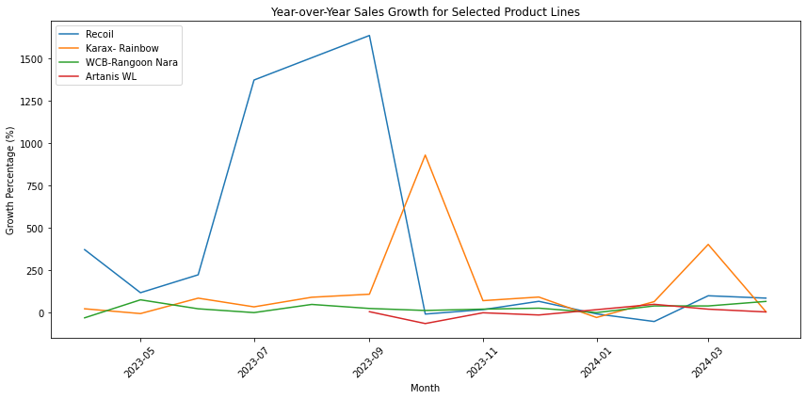
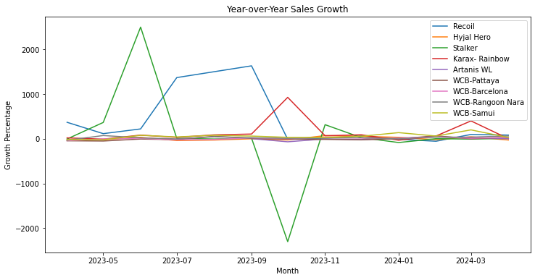
2) Sales Visualization
Line Charts

Slide 10

3) Inferences From Data
Growth Trends:
mix of positive and negative growth rates.
Seasonality:
"Karax- Rainbow" has consistently high growth rates in the second half of the year (September to December).
Variability:
"Recoil" and "Stalker" show high variability.
Consistency:
"WCB-Barcelona" and "WCB-Rangoon Nara" show relatively consistent growth rates.

Slide 11
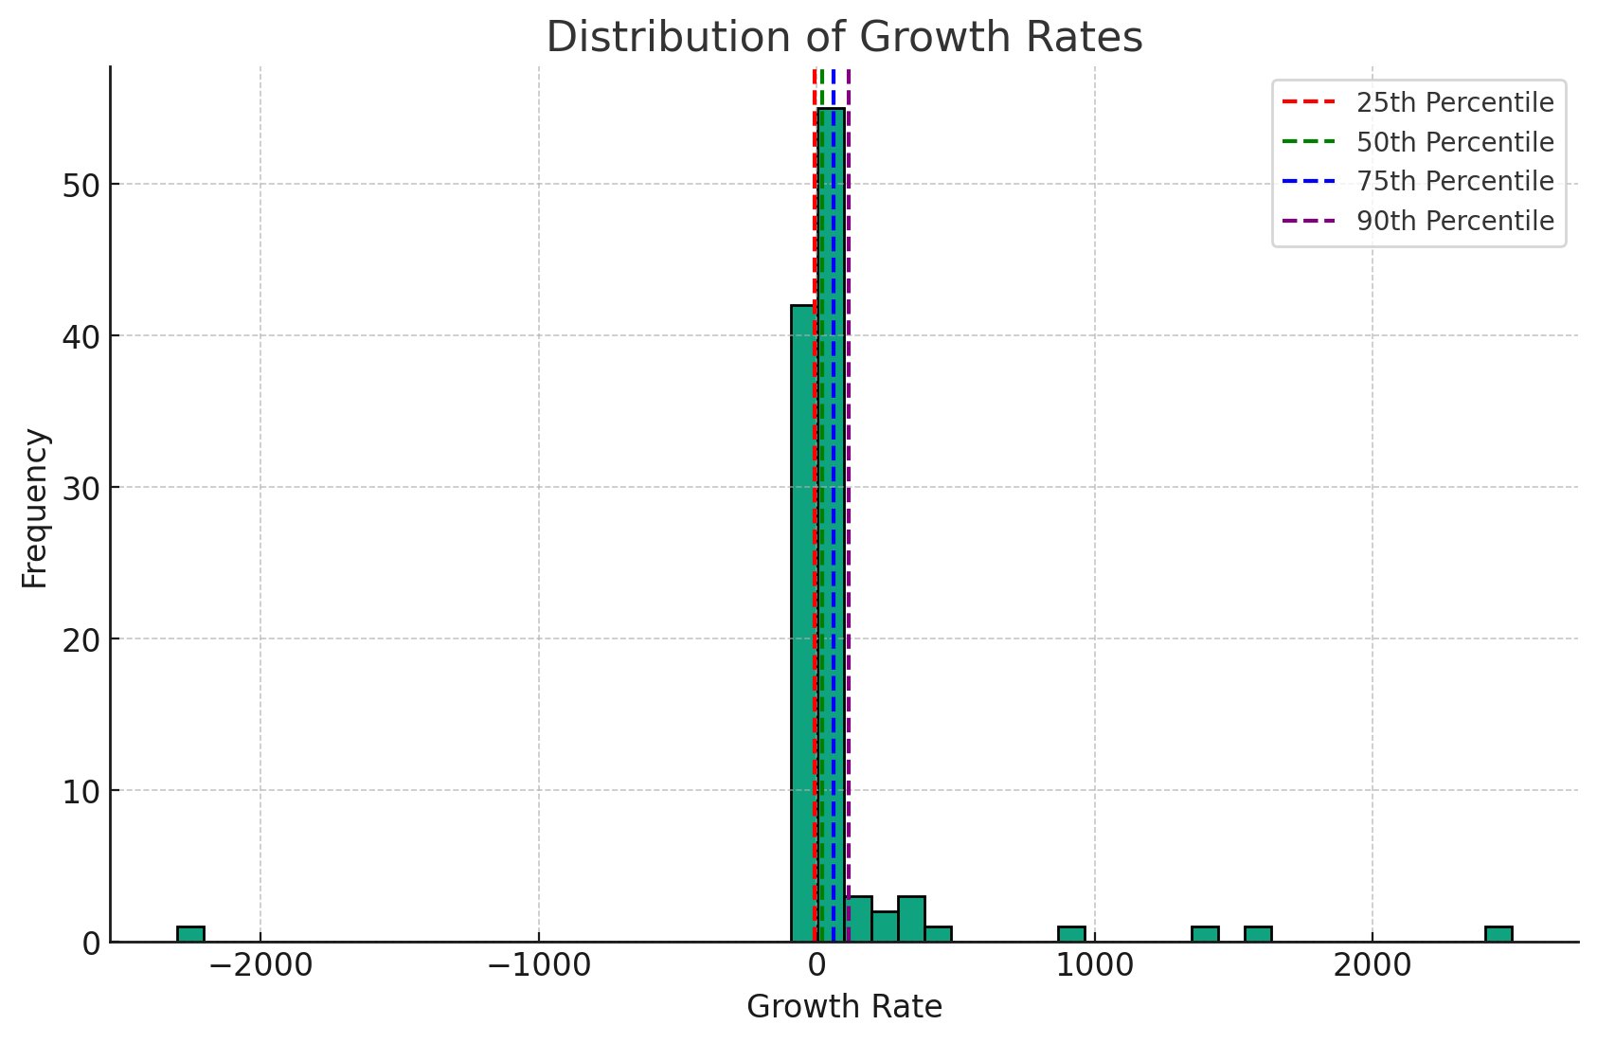

4) Tier Store Level Performance
thresholds = [-6.259, 19.028, 62.312, 116.242]
Mean
Median
25th Percentile: -6.259109765668796
50th Percentile: 19.028006589785832
75th Percentile: 62.31205275054753
90th Percentile: 116.24203821656052

Slide 12
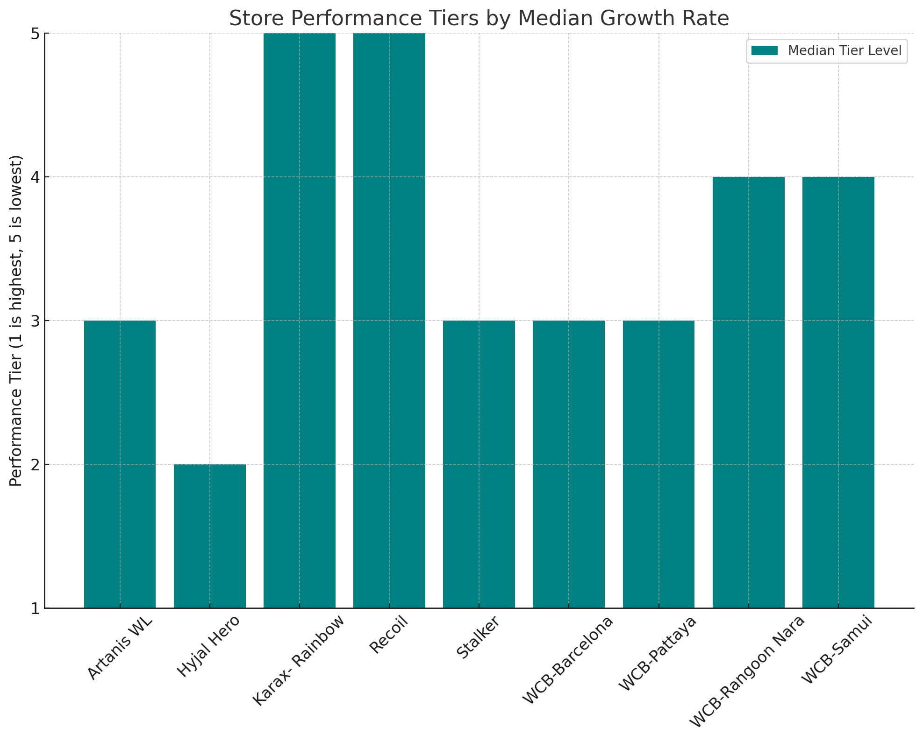
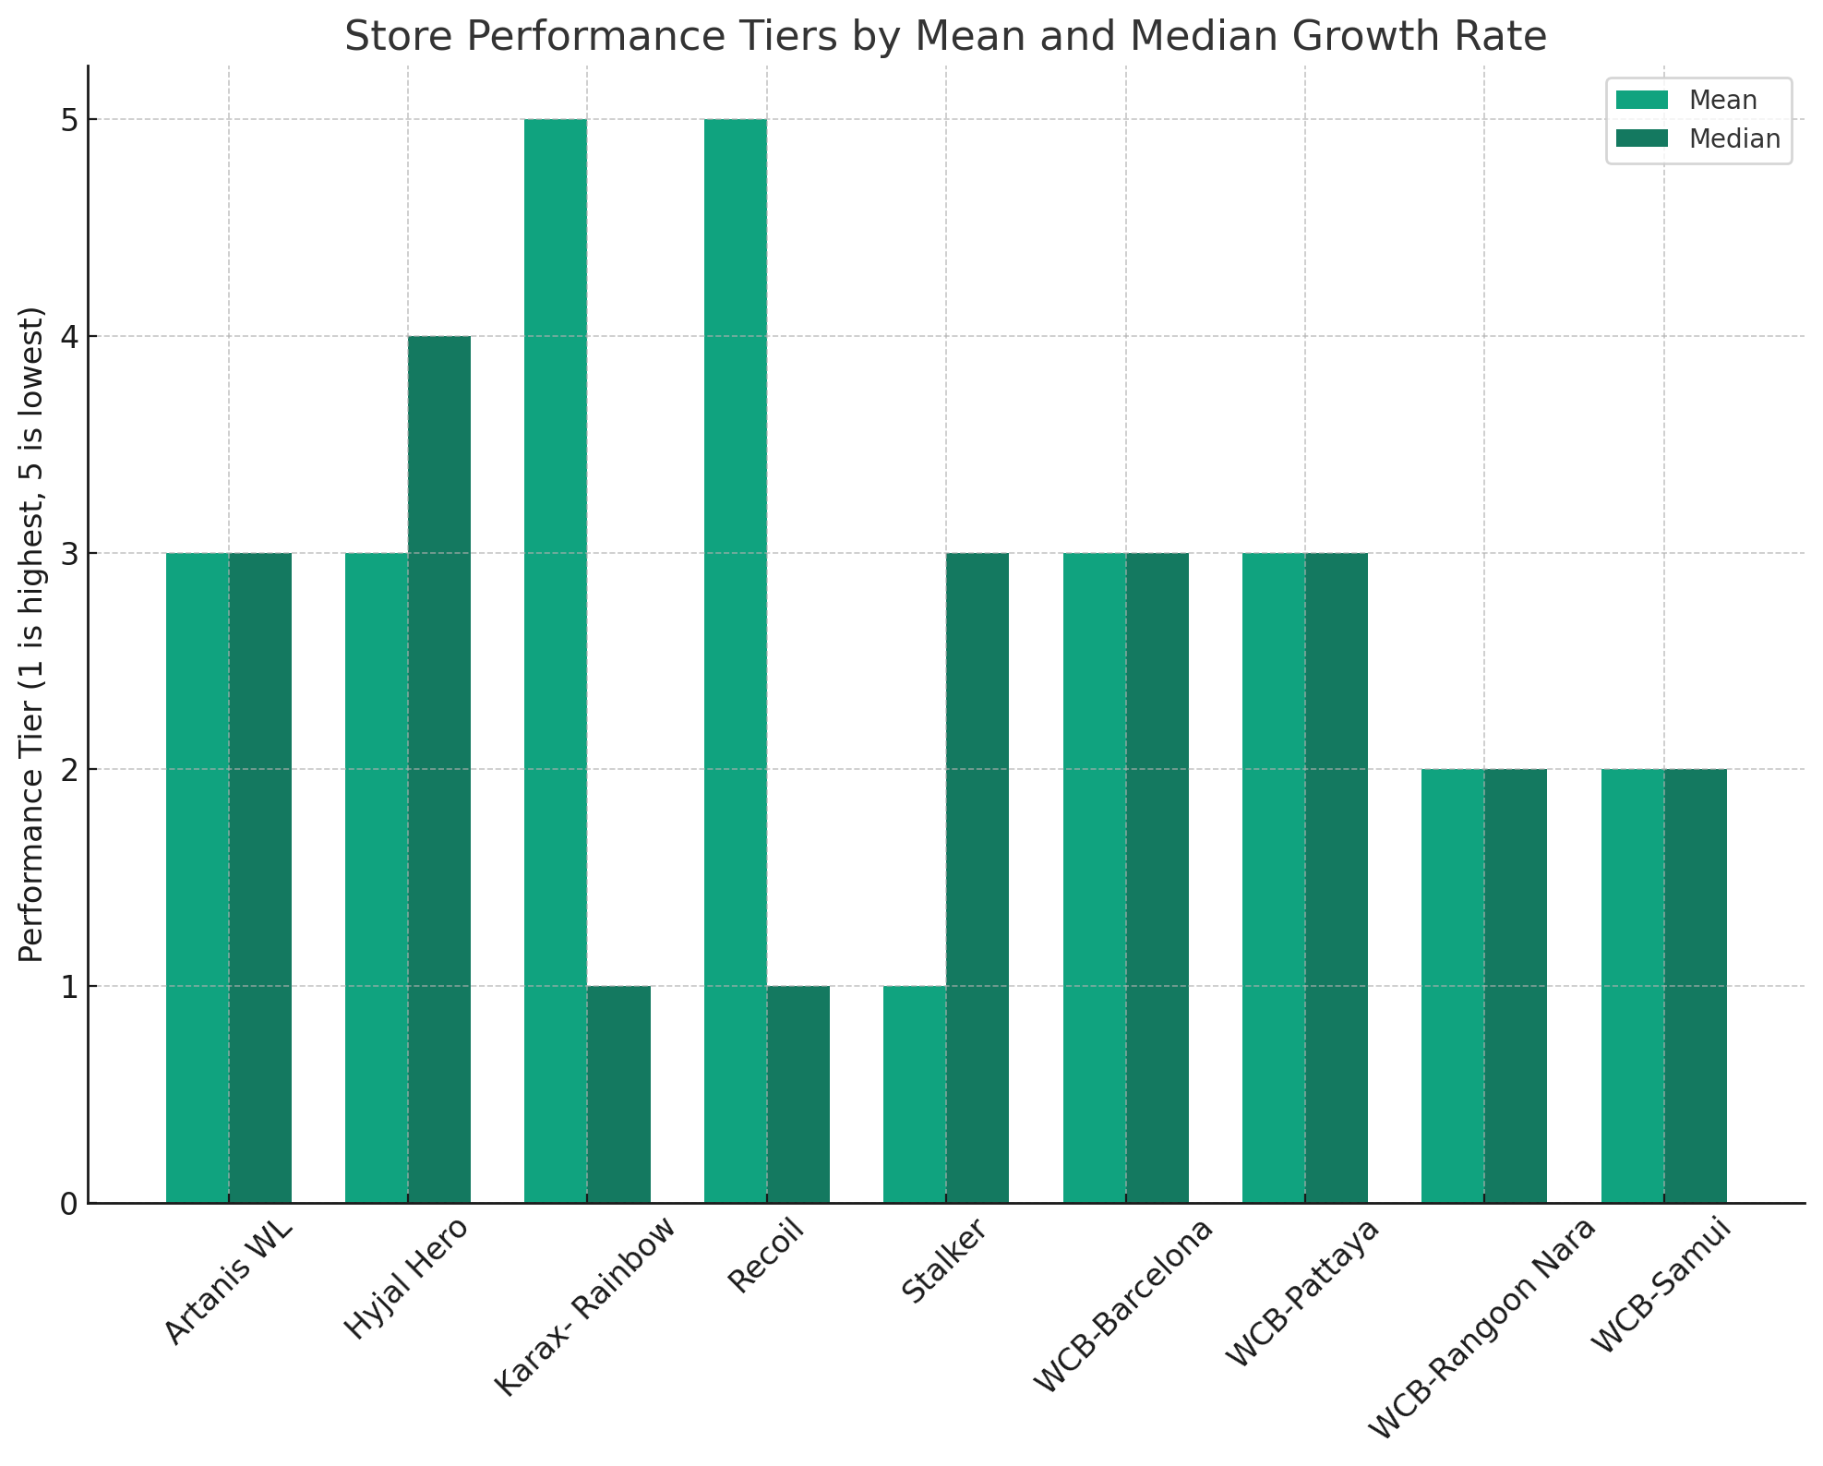
4) Tier Store Level Performance
Mean
✔️
Median

Slide 13
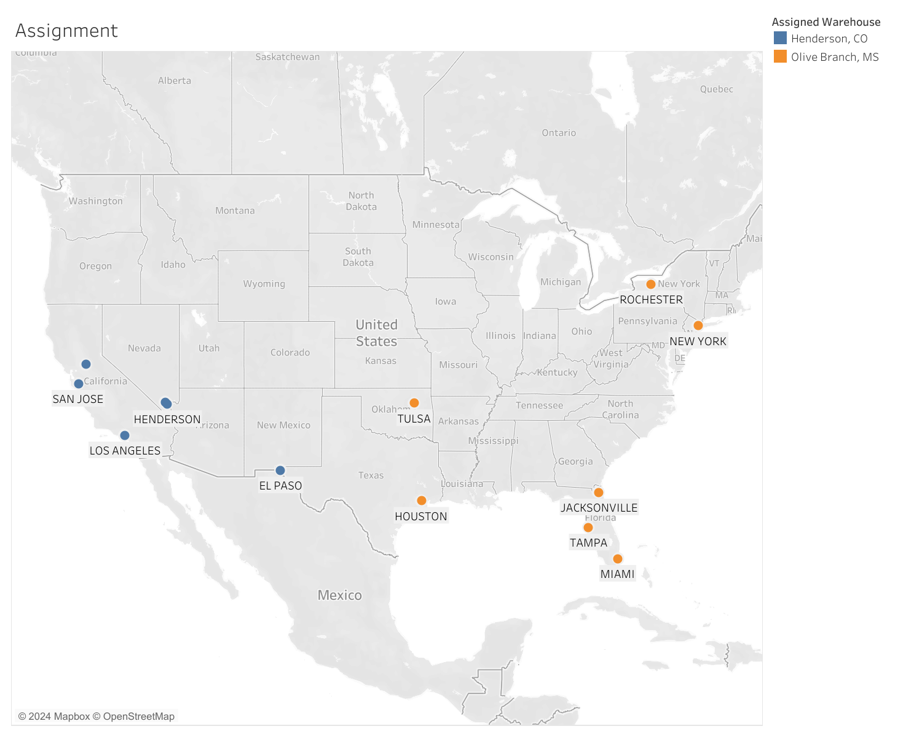

5) Store-Warehouse Selection
OpenCage - get Coordinates of stores
from geopy.distance import geodesic - get Distances from stores to warehouses

Slide 14
Thank You

